Slide 1
Combinational Logic Circuit

Slide 2
Combinational logic circuit
In previous lectures we have studied the operation of all the basic logic gates and we have used Boolean algebra to describe and analyze circuits that were made up of combinations of logic gates/circuits. These circuits can be classified as combinational logic circuits. Because at any time the logic level at the output depends on the combination of logic levels present at the inputs. A combinational circuit has no memory characteristic, so its output depends only on the current value of its inputs.

Slide 3
Simplification of logic circuits

Slide 4
Simplification of logic circuits
Two method:
Boolean algebra theorems
Mapping technique

Slide 5

Sum-of-products (SOP) method
Each sum of products expressions consists of two or more AND terms (products) that are ORed together. Each AND term consists of one or more variables individually appearing in either complemented or uncomplemented (not inverted) form.
Note that: in SOP expression, one inversion sign cannot cover more than one variable in a term.
Example: $1. ABC+\overline{A}B\overline{C}$
$2. AB+ \overline{A}B\overline{C}+\overline{C}\overline{D}+D$

Slide 6

Product-of-sums (pos) method
It consists of two or more OR terms (sums) that are ANDed together. Each OR term contains one or more variables in complemented or uncomplemented (not inverted) form.
Example: $1. \left(A+\overline{B}+C\right)\left(A+C\right)$
$$2.\left(A+\overline{B}\right)\left(\overline{C}+D\right)F$$

Slide 7

Simplify the expression
$$z=ABC+A\overline{B}.\left(\overline{\overline{A}\overline{C}}\right)$$
$=ABC+A\overline{B}\left(\overset{̿}{A}+\overset{̿}{C}\right)$Demorgan theorem
$=ABC+A\overline{B}\left(A+C\right)$
$=ABC+A\overline{B}A+A\overline{B}C$ $[A.A=A]$
$=ABC+A\overline{B}+A\overline{B}C$ expression now in SOP form
$z=AC\left(B+\overline{B}\right)+A\overline{B}; B+\overline{B}=$1
$$=AC+A\overline{B}$$
$$=A(C+\overline{B})$$

Slide 8

Simplify the expression
$$x=\left(\overline{A}+B\right)\left(A+B+D\right)\overline{D}$$
$= \overline{A}A\overline{D}+\overline{A}B\overline{D}+\overline{A}D\overline{D}+AB\overline{D}+BB\overline{D}+BD\overline{D}$
expression now in SOP form
$=$ $\overline{A}B\overline{D}+$ $AB\overline{D}+B\overline{D}$
$$=B\overline{D} \left(\overline{A}+A+1\right)$$
$$=B\overline{D}$$

Slide 9
Designing Combinational logic circuit

Slide 10
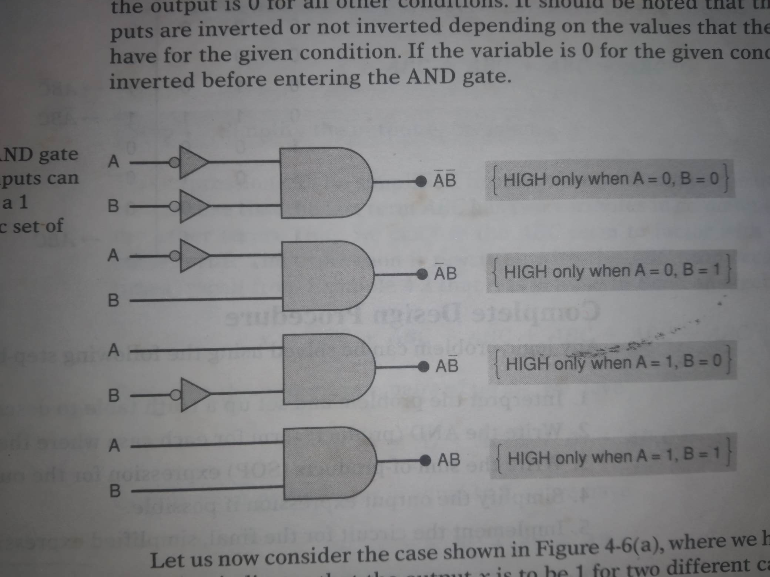
Designing Combinational logic circuit
An AND gate with appropriate inputs can be used to produce a 1 output for a specific set of input levels.

Slide 11
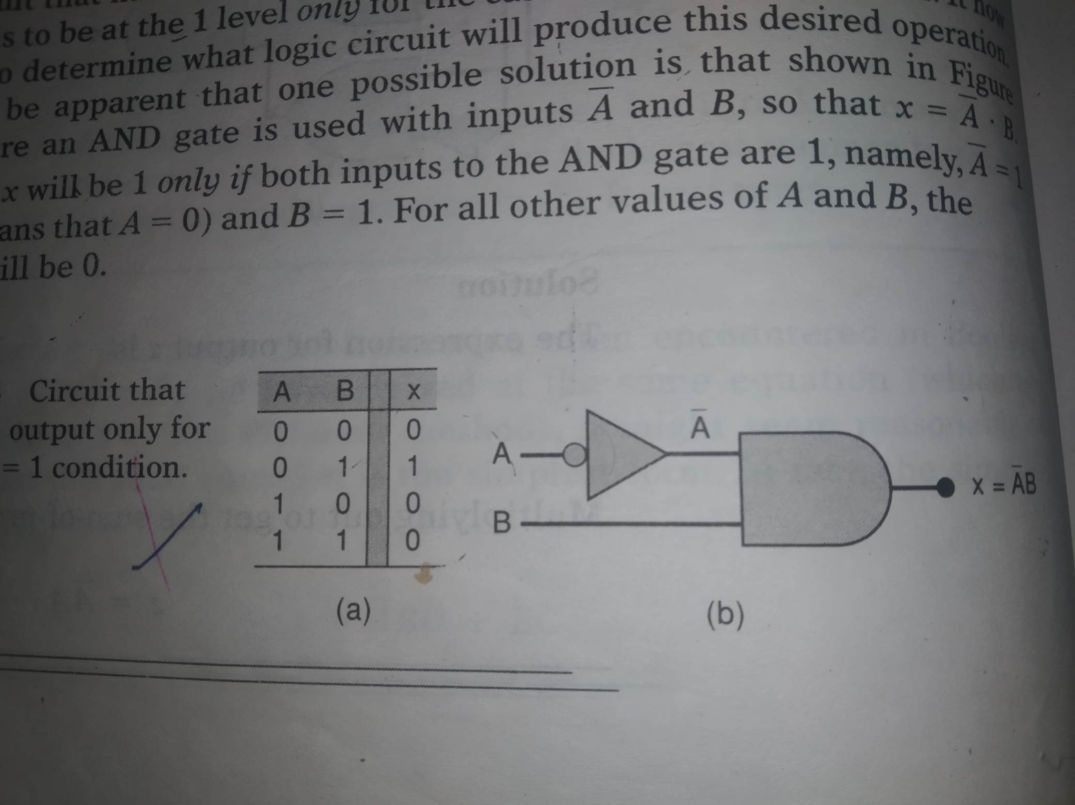
Designing Combinational logic circuit

Slide 12
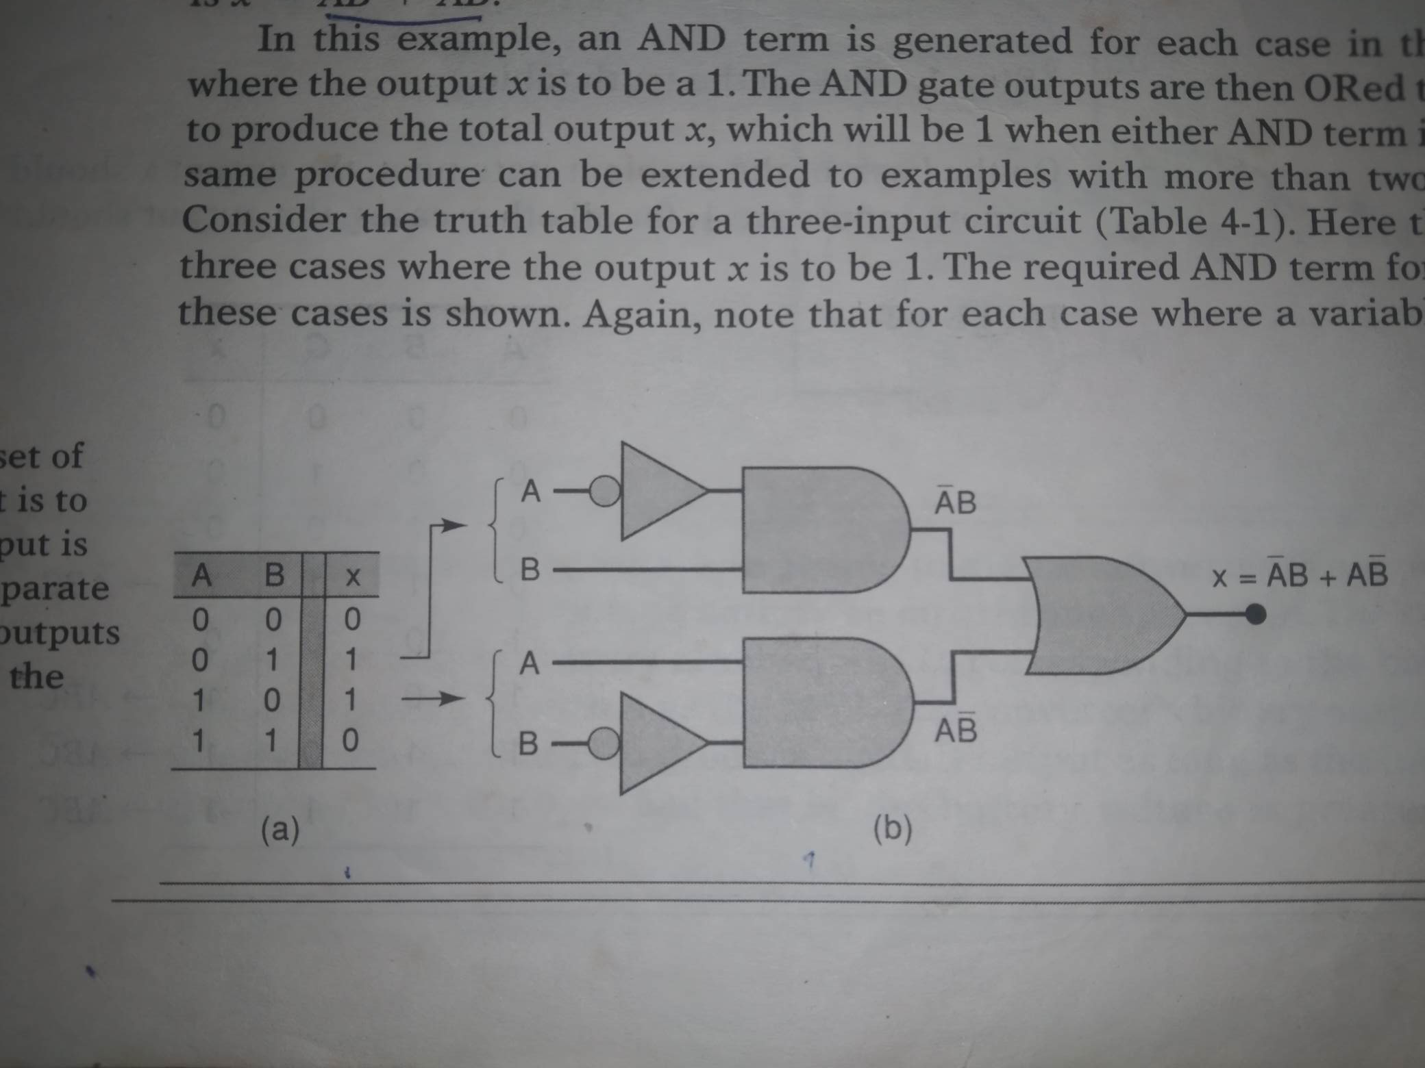
Designing Combinational logic circuit

Slide 13
Design procedure
Interpret the problem and set up a truth table to describe its operation.
Write the AND (product) term for each case where the output is 1.
Write the SOP expression for the output.
Simplify the output expression if possible.
Implement the circuit for the final, simplified expression.

Slide 14
Design combinational logic circuit
Question: Design a logic circuit that has three inputs A, B and C and whose output will be HIGH only when a majority of the inputs are HIGH.

Slide 15
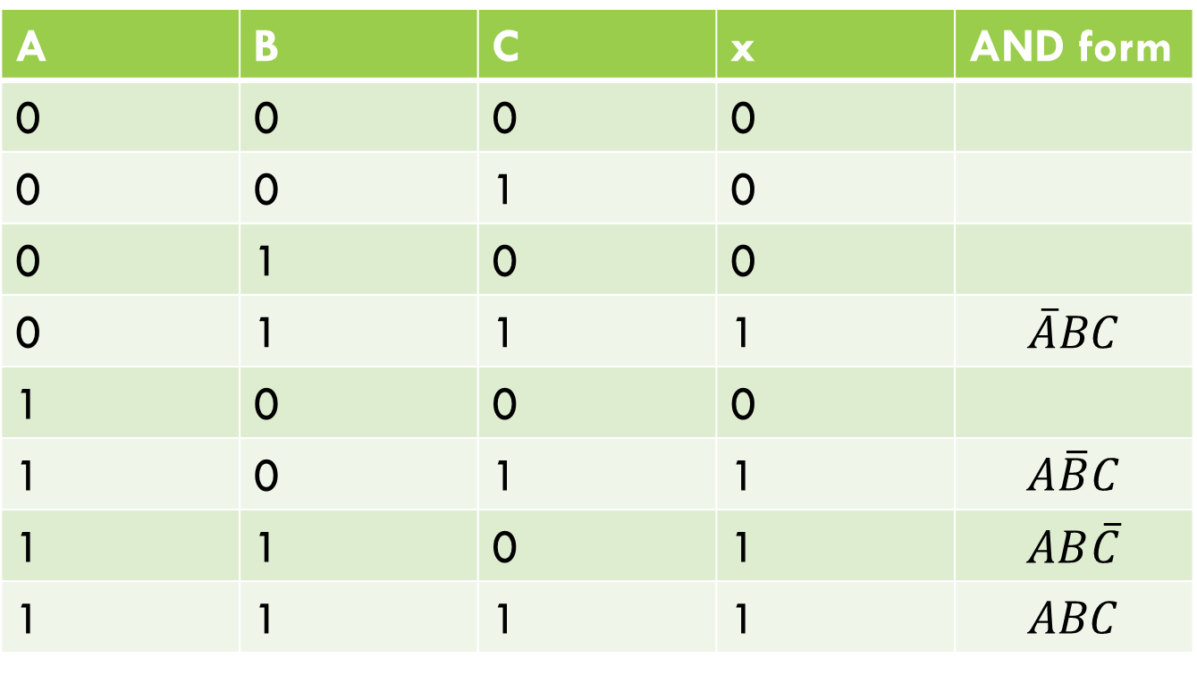
Design combinational logic circuit
Question: Design a logic circuit that has three inputs A, B and C and whose output will be HIGH only when a majority of the inputs are HIGH.
A | B | C | x | AND form
0 | 0 | 0 | 0
0 | 0 | 1 | 0
0 | 1 | 0 | 0
0 | 1 | 1 | 1 | $$\overline{A}BC$$
1 | 0 | 0 | 0
1 | 0 | 1 | 1 | $$A\overline{B}C$$
1 | 1 | 0 | 1 | $$AB\overline{C}$$
1 | 1 | 1 | 1 | $$ABC$$

Slide 16

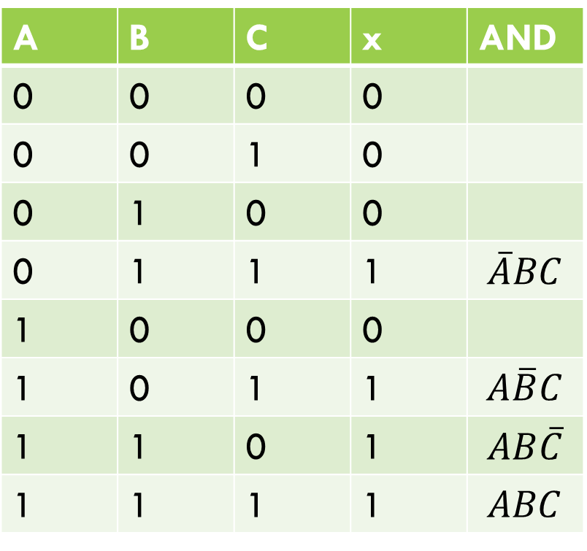
Design combinational logic circuit
Question: Design a logic circuit that has three inputs A, B and C and whose output will be HIGH only when a majority of the inputs are HIGH.
A | B | C | x | AND
0 | 0 | 0 | 0
0 | 0 | 1 | 0
0 | 1 | 0 | 0
0 | 1 | 1 | 1 | $$\overline{A}BC$$
1 | 0 | 0 | 0
1 | 0 | 1 | 1 | $$A\overline{B}C$$
1 | 1 | 0 | 1 | $$AB\overline{C}$$
1 | 1 | 1 | 1 | $$ABC$$
SOP expression:
x= $\overline{A}BC$+$A\overline{B}C$+$AB\overline{C}+ABC$
=$BC+AC+AB$
Finally draw the circuit. (homework)

Slide 17
Karnaugh map method
K map is a graphical tool used to simplify a logic equation or to convert a truth table to its corresponding logic circuit in a simple, orderly process. It is a systematic step by step process. Its practical usefulness is limited to five or six variables.

Slide 18
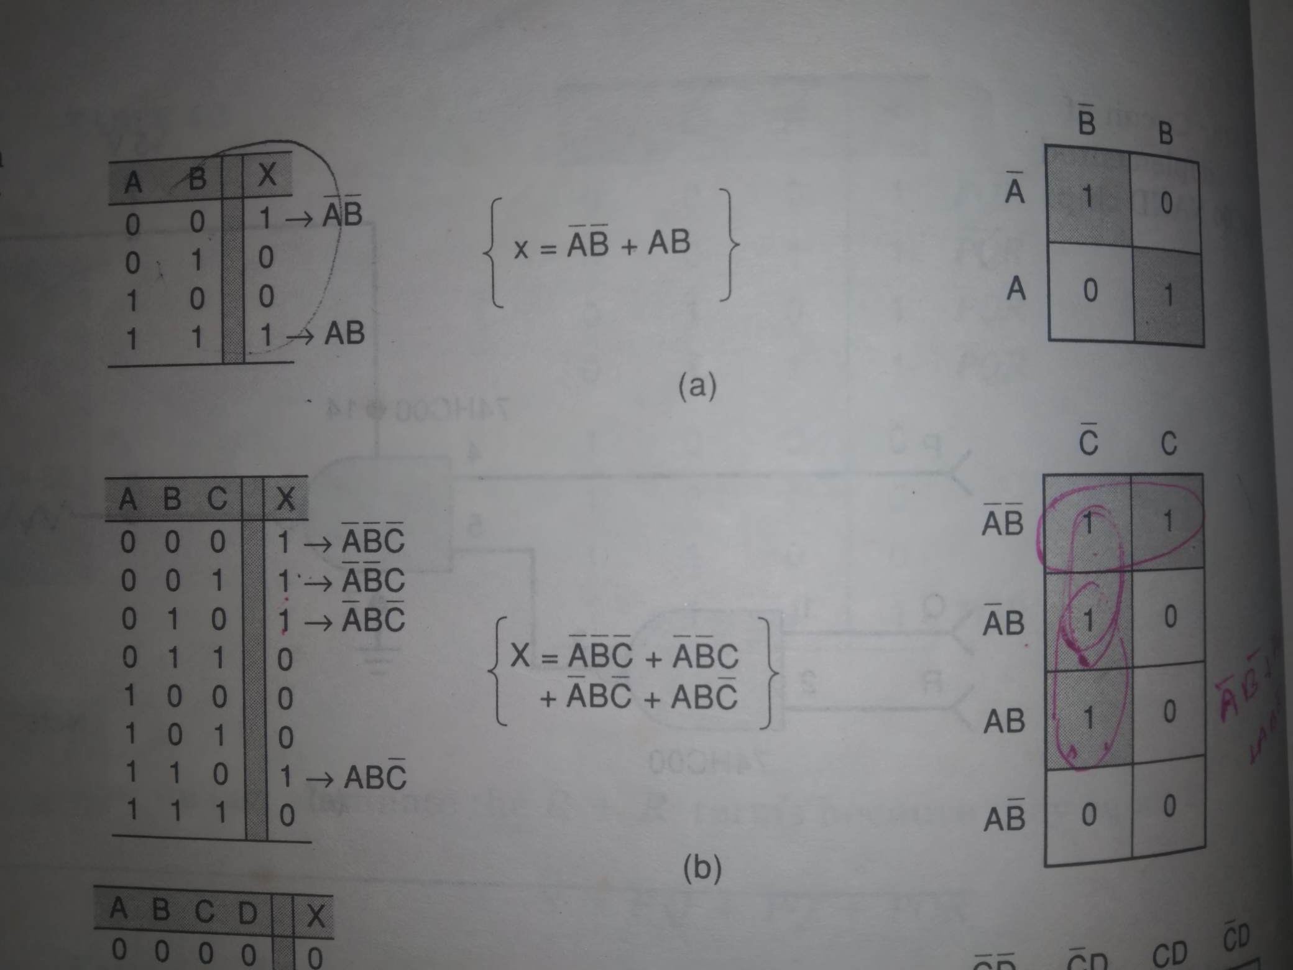
K-map and truth tables (for 2, 3 and 4 variables)

Slide 19
K-map and truth tables (for 2, 3 and 4 variables)

Slide 20
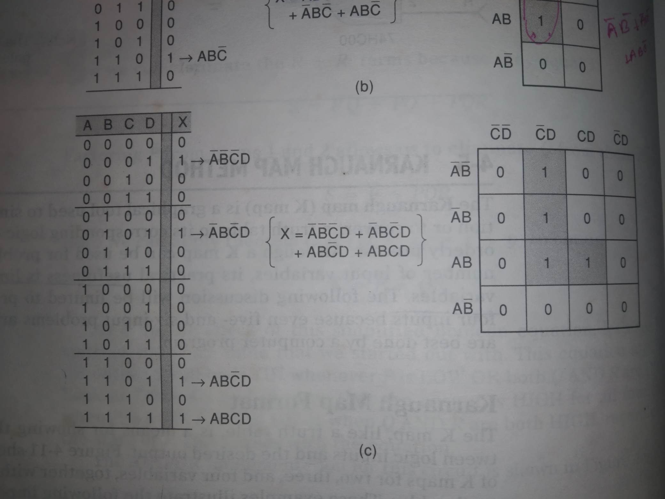
K-map and truth tables (for 2, 3 and 4 variables)

Slide 21
Looping

Slide 22
Looping
The expression for output X can be simplified by properly combining those squares in the K-map that contain 1s. The process for combining these 1s is called looping.
Result: Looping a pair of adjacent 1s in a K-map eliminates the variable that appears in complemented and uncomplemented form.

Slide 23
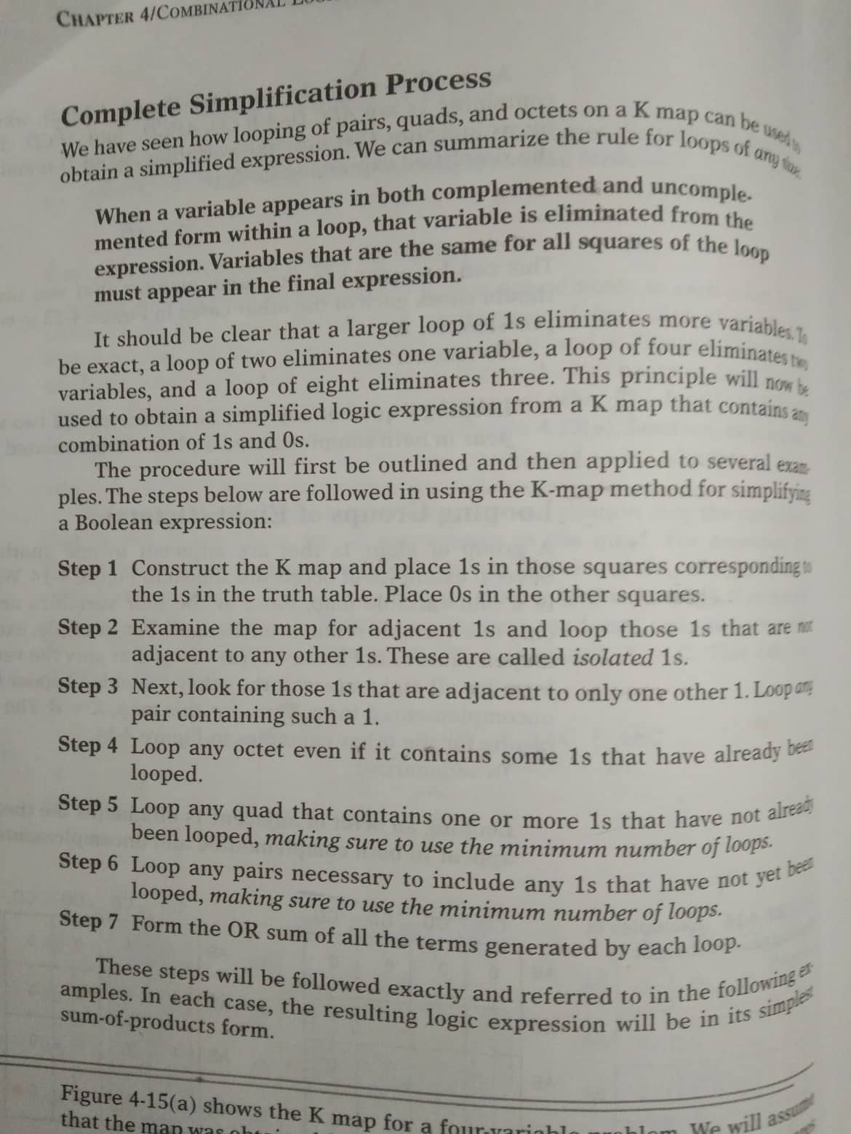

Slide 24
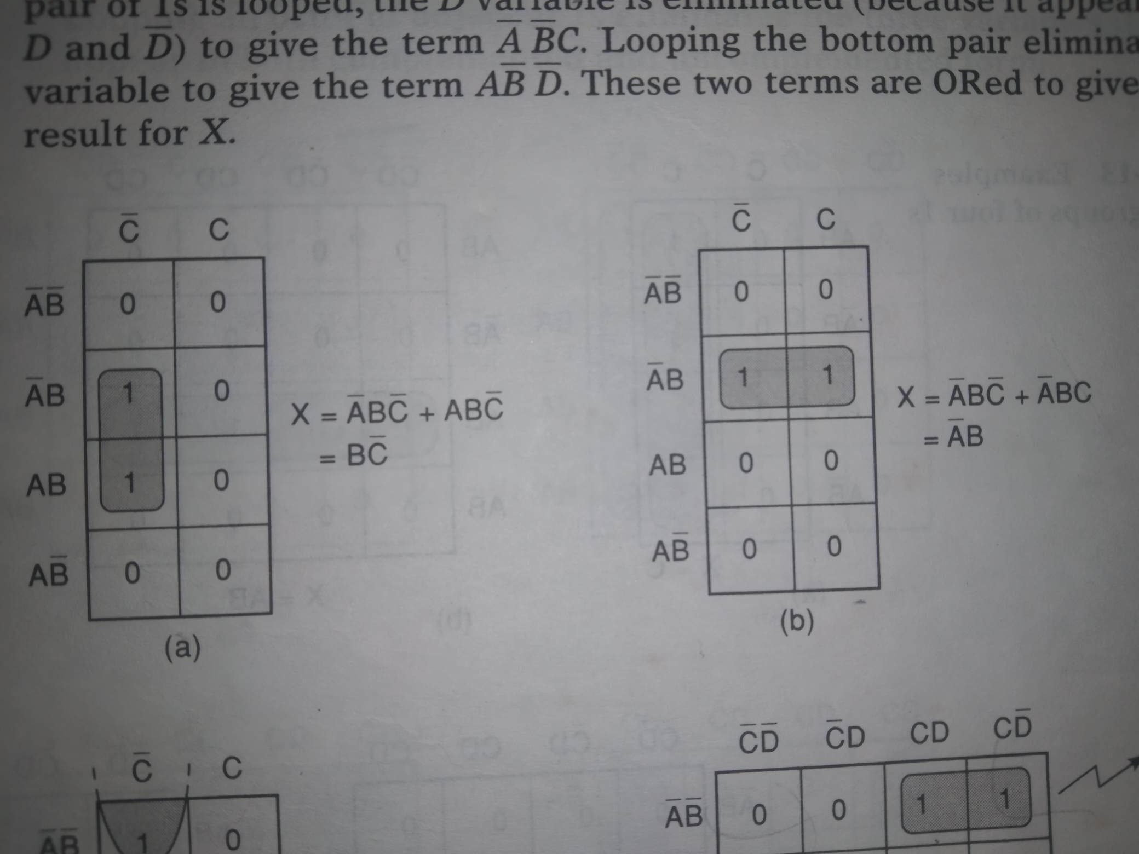
Looping (groups of Two/pairs) looping pairs of adjacent 1s

Slide 25
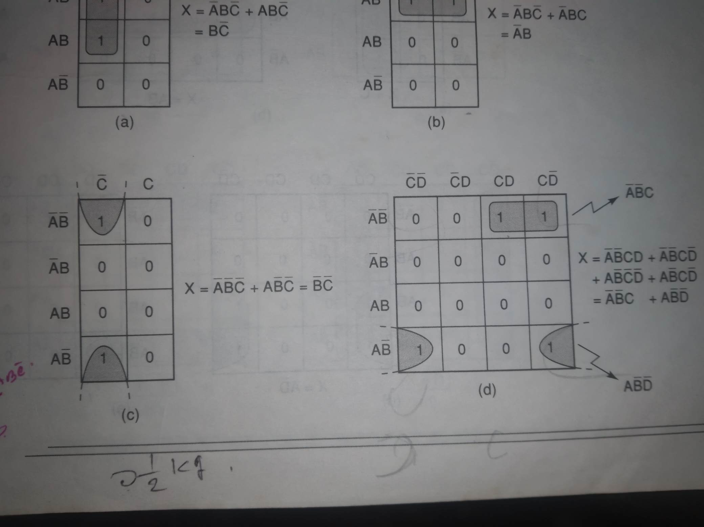
Looping (groups of Two/pairs) lo0ping pairs of adjacent 1s

Slide 26
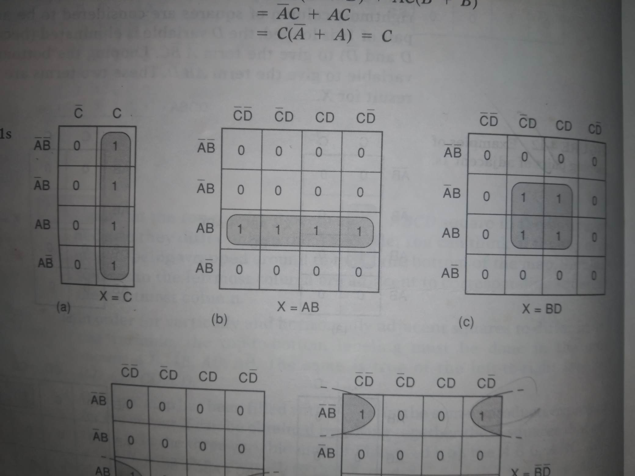
Looping (groups of four/ Quads)

Slide 27
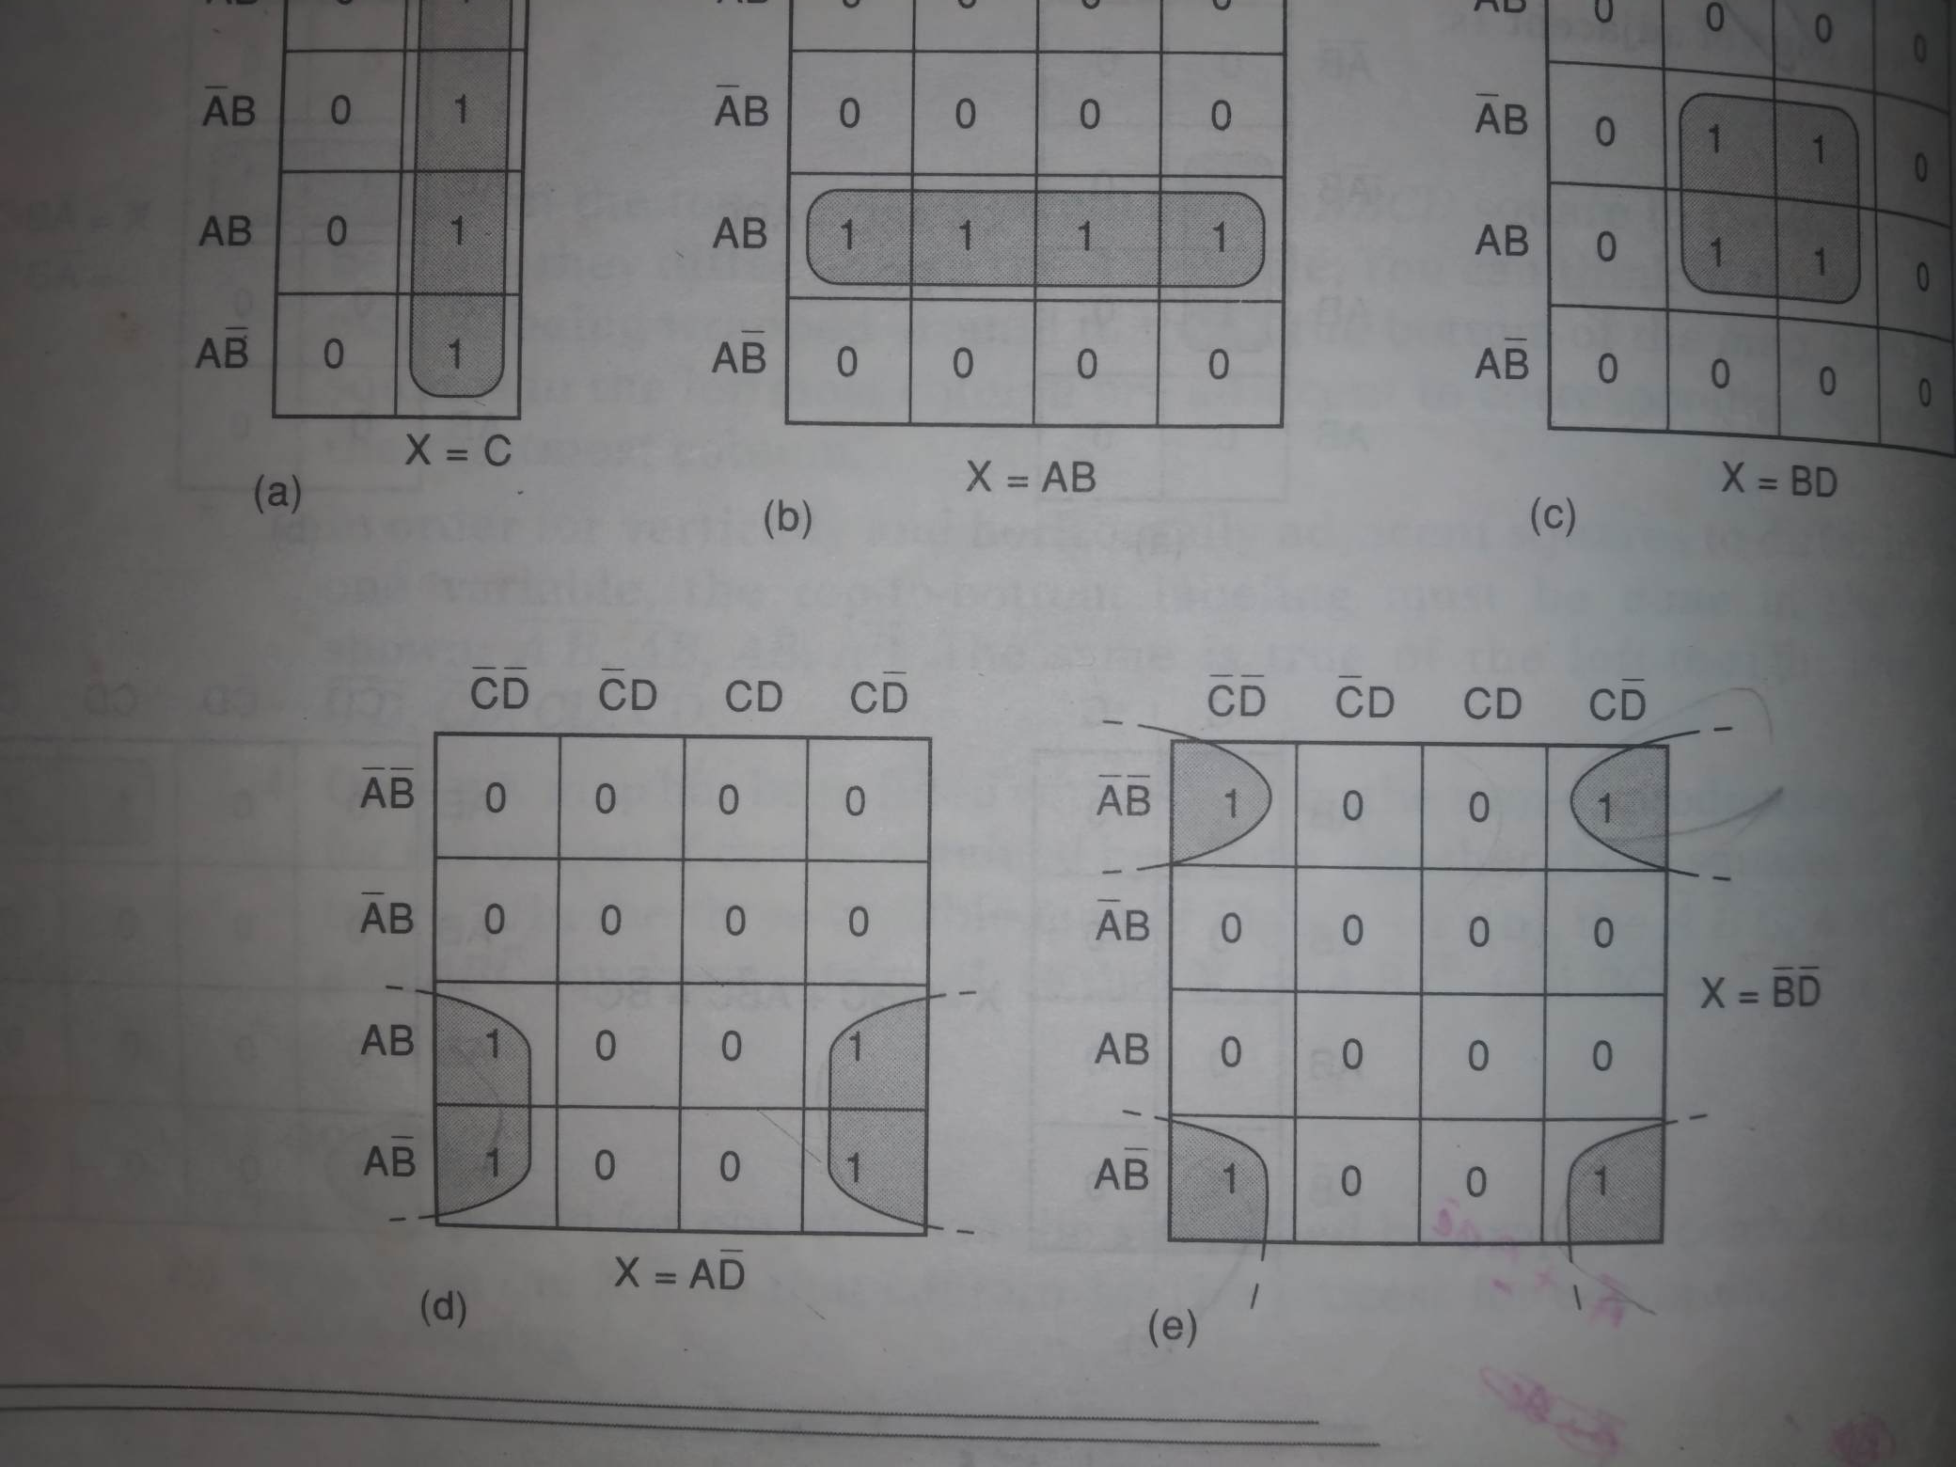
Looping (groups of four/ Quads)

Slide 28
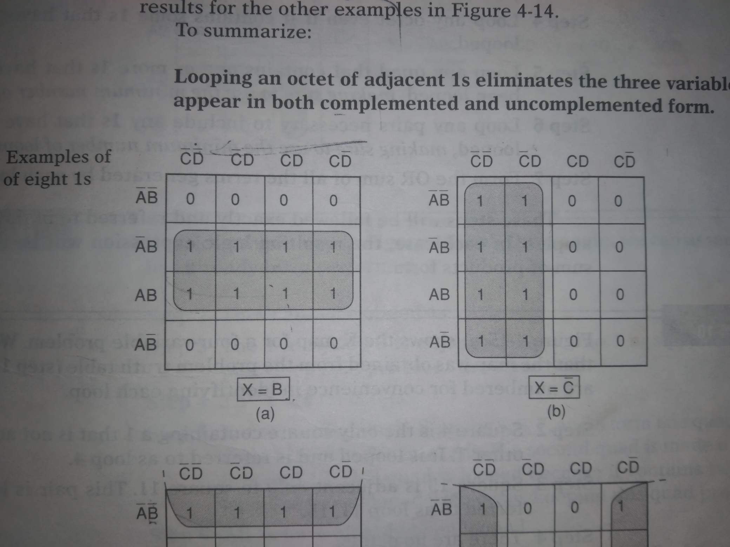
Looping (groups of eight/octets)

Slide 29
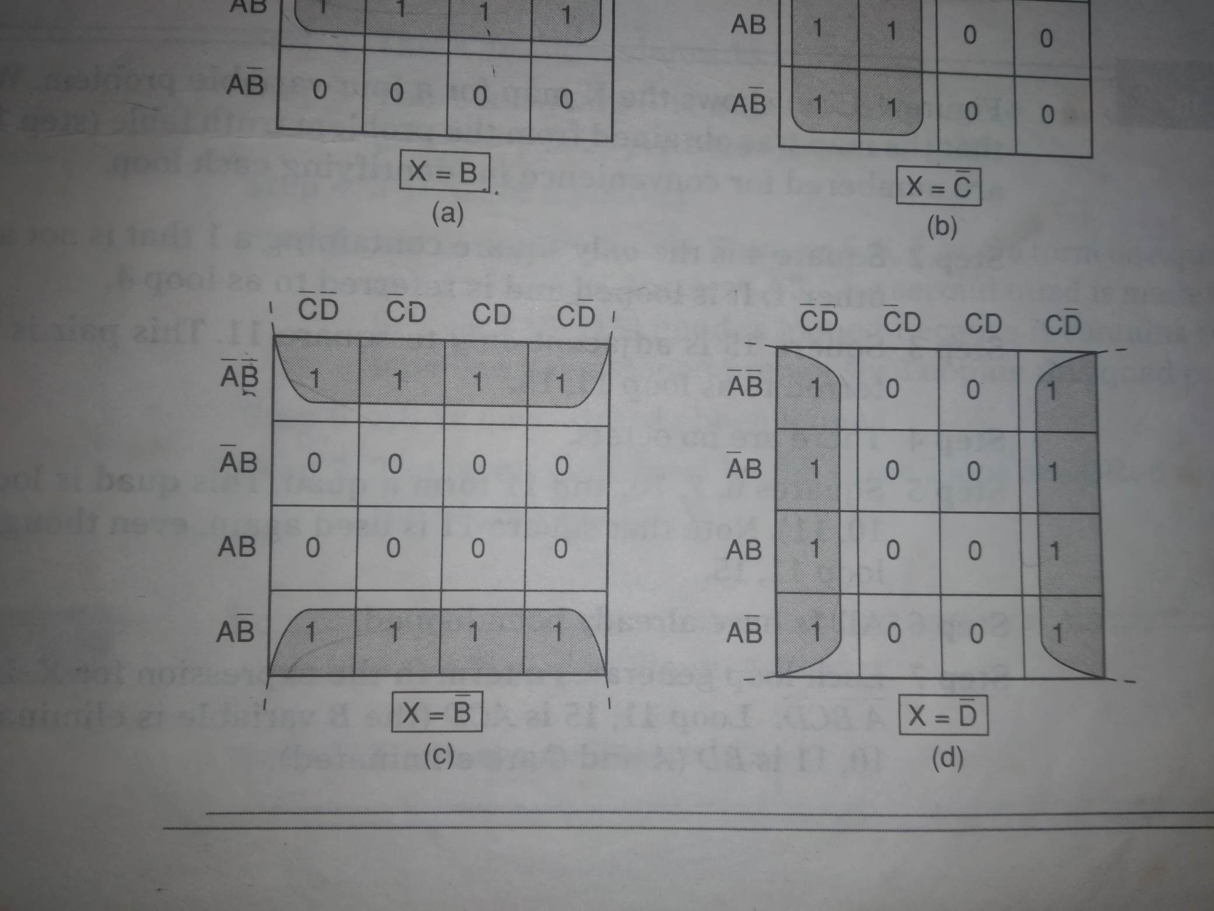
Looping (groups of eight/octets)

Slide 30
Don’t care conditions
Some logic circuits can be designed so that there are certain input conditions for which there are no specified output levels, usually because these input condition will never occur. In other words, there will be certain combinations of input levels where we don’t care whether the output is HIGH or LOW.
Benefit: Don’t care conditions should be changed to 0 or 1 to produce K-map looping that yields the simplest expression.

Slide 31
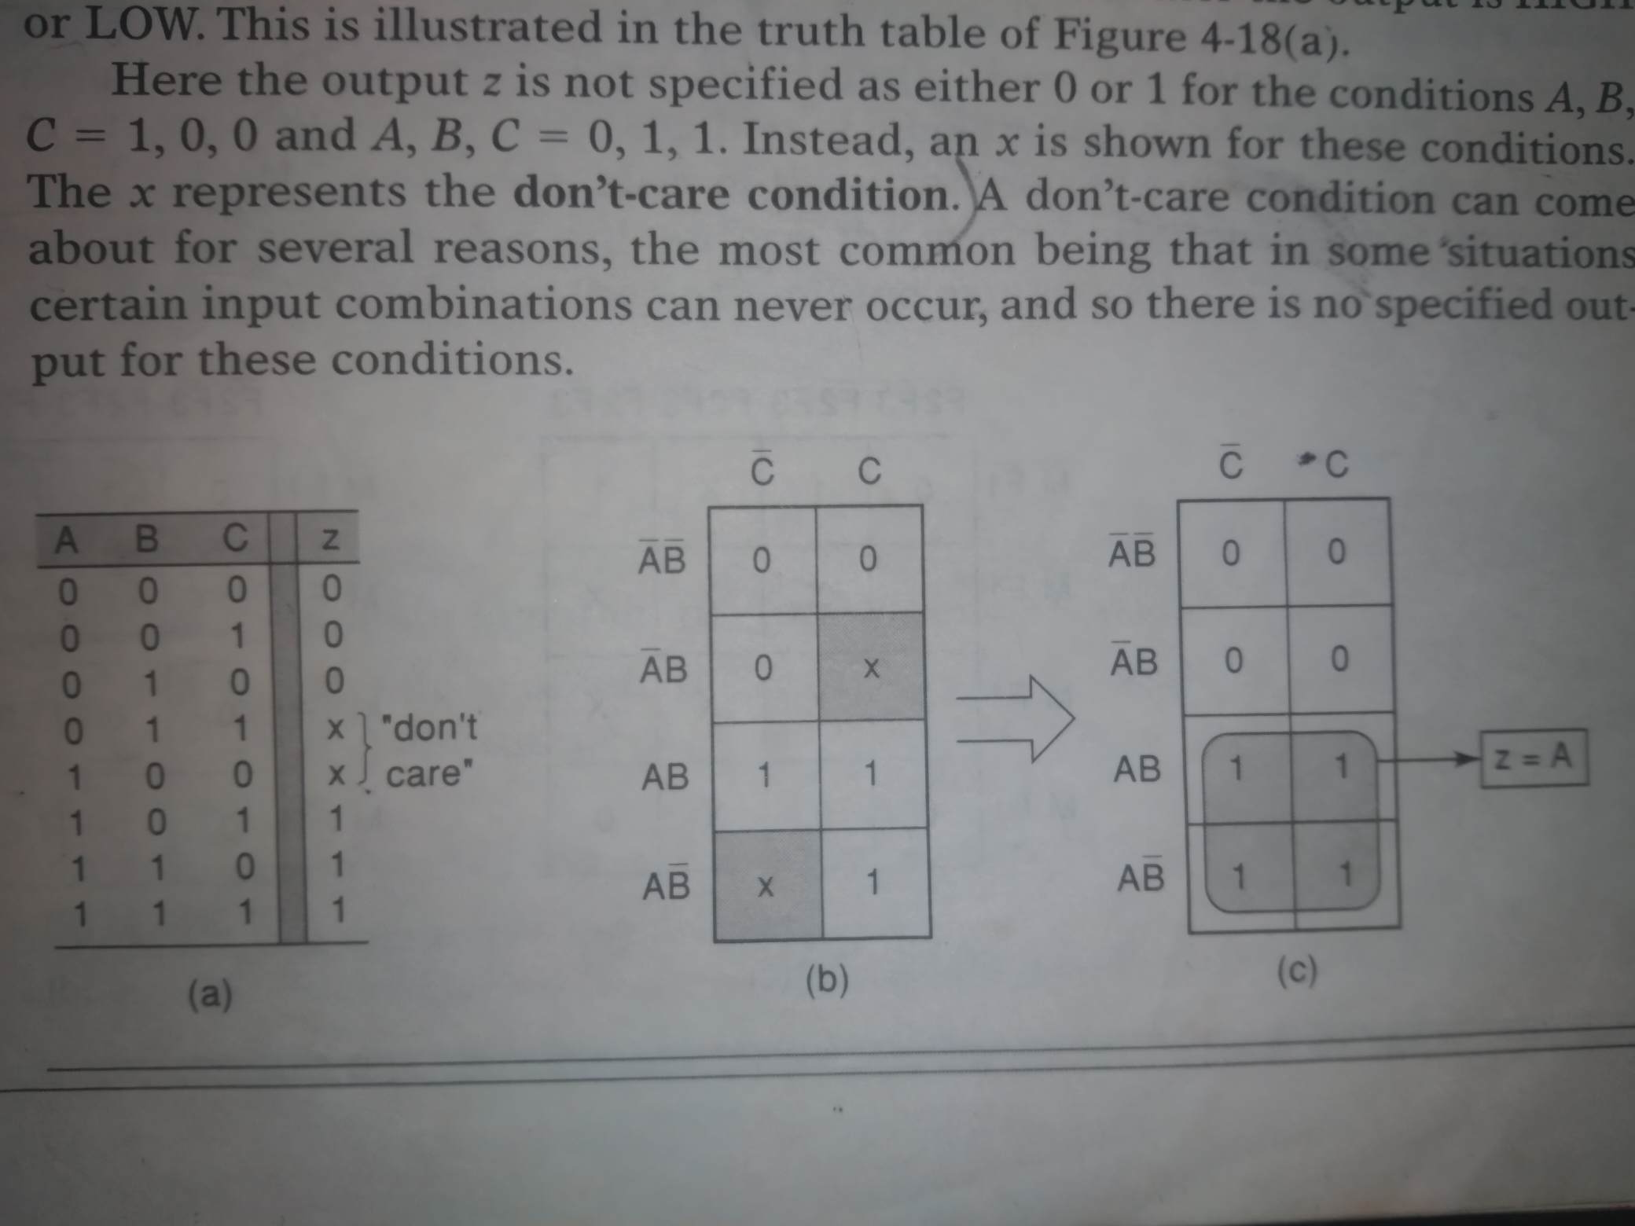
Don’t care conditions

